Slide 1
Utility Management Training PollEv Session 1

Slide 2
Notes:
Poll Title: What stops water utilities from attracting talent? https://www.polleverywhere.com/multiple_choice_polls/MFb1g39kAQf8gdnO3cECe

Slide 3
Notes:
Poll Title: If you compare the complex management skills of the senior management team of a sizeable Eastern European water utility (10 million-euro turnover, 500 employees) to the management team of a similar-size company in a private competitive market in the same region, would you say that? https://www.polleverywhere.com/multiple_choice_polls/MhpCo6ggU9b6LQGOGySBm

Slide 4
Notes:
Poll Title: If you were (are) a CEO of a large water utility what would be the most desired skills and characteristics of your senior and mid-level managers? https://www.polleverywhere.com/free_text_polls/TjKIsBmolnyJOOF0aGzxj

Slide 5
The Need for and Potential of Developing a Utility Management Programme in the Danube Region What if it works…

Slide 6
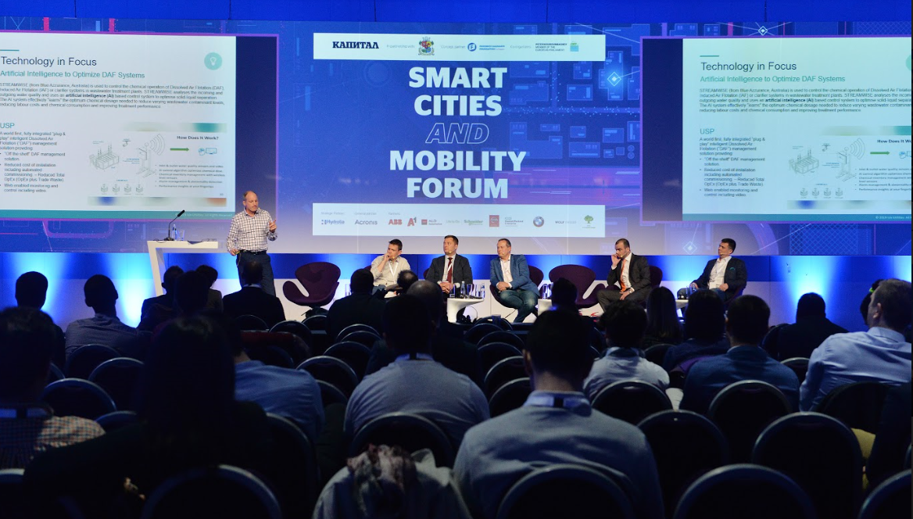

Slide 7
What is the single most important reason that stops water utilities globally to actively deploy technologies (one-word answer required)?

Slide 8
CULTURE

Slide 9
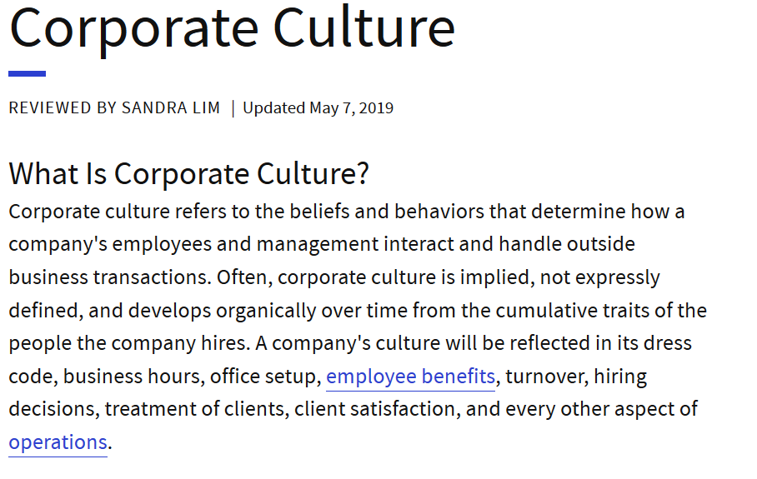
Source: Investopedia

Slide 10
What Have We Done So Far:
Capacity Building Programmes / Trainings: RCDN, D – LeaP, country-specific trainings, corporate training initiatives, etc.
Utility Strengthening Programmes of IFIs and Donors: corporate strengthening, FOPIPs, etc.
Peer-to-peer exchanges
CAPEX financing combined with capacity strengthening
Private sector involvement through concessions and management contracts

Slide 11
Utility Management Training PollEv Session 2

Slide 12
Notes:
Poll Title: Identify the skills that are most often needed but absent in a mid-level utility manager (or a senior expert) on her/his path to a senior-manager role in a water utility (technical director, commercial director, CEO)? https://www.polleverywhere.com/free_text_polls/ufRKMYZelrzVHMZAVv4hs

Slide 13
Notes:
Poll Title: What is the most effective and efficient way of gaining comprehensive management expertise? https://www.polleverywhere.com/multiple_choice_polls/HF6Sx3DW1yaOT6RDfdTTA

Slide 14
Notes:
Poll Title: If you are/were the CEO of a large Eastern European water utility how much would you be willing to pay for a promising junior manager to attend a comprehensive Diploma Programme in Utility Management 2-3 years modular programme delivered via a combination of on-campus and distance learning? https://www.polleverywhere.com/free_text_polls/GPgqcnsBpVC4P8j1PaBeO

Slide 15
Notes:
Poll Title: If you are/were a mid-level manager (expert) who considers attending a comprehensive Diploma course in Utility Management how much time would you be able and willing to devote to participation and remote learning per year (assume 2 years in total)? https://www.polleverywhere.com/free_text_polls/wLxNaFCL26BKj8Z51fTZ3

Slide 16
Can we do something that: (1) specifically targets current and future utility managers (2) covers technical, commercial, financial and organizational aspects (3) is affordable ($ and time) (4) is (regionally) recognized

Slide 17
Target Audience
Mid-level managers progressing towards senior management:
Technical/Operations managers (network managers, plant managers) with limited exposure to financial and commercial areas
Commercial/Customer-Service/Legal managers with limited understanding of operations
Key experts (compliance officers, process engineers, H&S, legal experts) with limited exposure to management practices (budgeting, people management, etc.)
Newcomers to the water-utility industry (management experience from other sectors but no comprehensive understanding of water-sector specifics)
Public-sector representatives with substantial responsibilities in water (regulatory, policy making, governance, OPE managing authorities, etc.)
Private-sector representatives with dedicated focus on water (product managers of vendors to water utilities)

Slide 18
Thematic Coverage (Curriculum)
Technical / Operations Management
Economic / Organizational Management
Network Operations
Financial Management
Plant Operations (PWTP and WWTP)
Commercial Management *
Energy Management *
Customer Service
Asset Management and Investment Planning *
Utility Economics, Regulation and Risk Management
* Curriculum Available Within D-LeaP

Slide 19
Making it Practical: Indicative Tools and Techniques to be Introduced within the Utility- Specific Topics
Technical Areas |  | Economic Areas
Operations Management | AM and Investment Planning | Utility Financial Management | Commercial Management
Water Audit approaches and Water Balance Energy Audit approaches and Energy Balance Process Maps Introduction of Preventative Maintenance Plans | Asset Registers Condition Assessment Lifecycle Asset Planning Investment Programme structuring | Budgeting based on Cost Centres of utility companies Actuals-vs-Budget processes Activity Based Costing Management of Procurement and Stores Outsourcing decisions | Billed volumes and variance analyses Transaction reporting Aged-debt reporting
One of the core concepts of the proposed approach is the link between Management and Operations levels within utilities.

Slide 20
Convenience and Affordability
Indicative Format and Duration:
8 one-week residential modules, one module per quarter
5-10 hours per week homework/remote exercises
Diploma project (base on real case)
Price: up to EUR 10 000 for the full programme

Slide 21
Recognition / Accreditation Opportunity for jointly-branded programme “IAWD – Sofia University Utility Management Training”

Slide 22
UMT Programme: Why Possible?
Network of IAWD/DWP
Availability of D-LeaP Programmes, trainers, d-leap academy
Consistent understanding of the need for a UMT identified through the Benchmarking programme
Aligned strategies of IFIs and donors (?)
Demand from both leading and poorly-performing utilities (?)

Slide 23
Everything presented here is just an initial concept. We would like to use the Danube Water Conference to actively brainstorm the idea. Thank you! D-LeaP Team Vienna May 20, 2019

